Slide 1
Beige Books Analysis
Liberating Textual Data | Data Scholars: Pathways Seminars Analysing Sentiment of the U.S. Economic Conditions in San Francisco (2000-2010)
Keiko Kamei
(Ervin Baccay & Dee Guo)

Slide 2

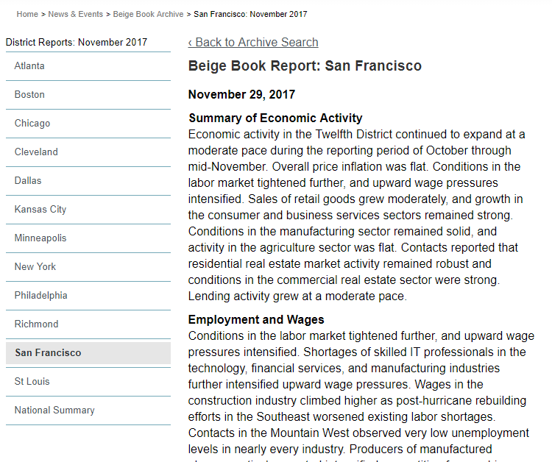
What is the Beige Books?
Summary of current economic conditions released by the Federal Reserve eight times per year, dating back to 1970
Organized by the twelve Federal Reserve Districts and their economic sectors
For this project, my team scraped and parsed the poorly structured, hard to navigate government data from the Federal Reserve Bank of Minneapolis and constructed a organized data frame with 25,000+ records!

Slide 3
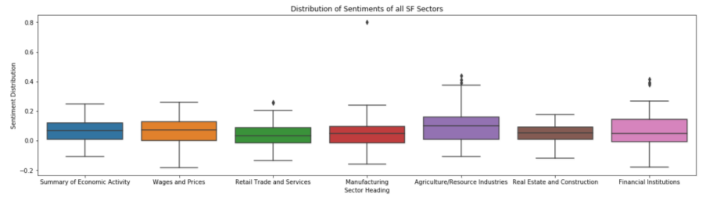
Analysis!
Since analysis is based on sentiment, my initial hypothesis was that the sentiment value of economic conditions would decrease across all sectors at the burst of the 2008 housing bubble.
From our newly structured government csv data, I conducted sentiment analysis on records in the 2000s to see if I could detect how well the economy was doing in different sectors in San Francisco.

Slide 4
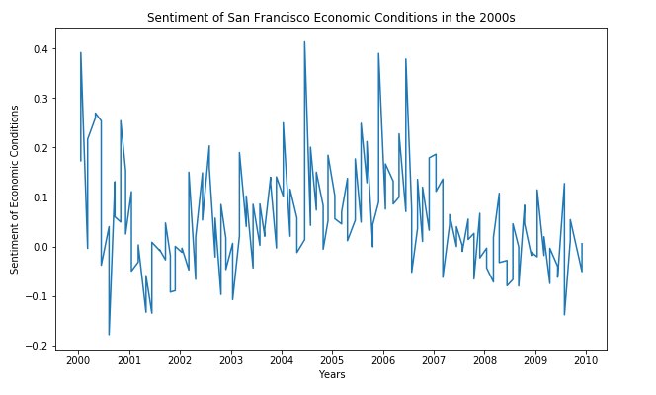
Conclusion
As predicted, we see a dramatic decline in economic sentiment at 2007
Further, we note that sentiment also dramatically dips in 2001, very likely reflecting the catastrophic events that took place on November 11th.
The graphs of every individual economic sector in San Francisco demonstrates the same trend, indicating the major national events took a toll across all sectors.
Above all, this indicates that we are able to detect the economic condition of the United States simply based on the tone that the Federal Reserve’s reports are written!

